Slide 1
What Drives “China Threat” Discourse?
Is threat of China perceived by the West driven by China’s growing power?

Slide 2
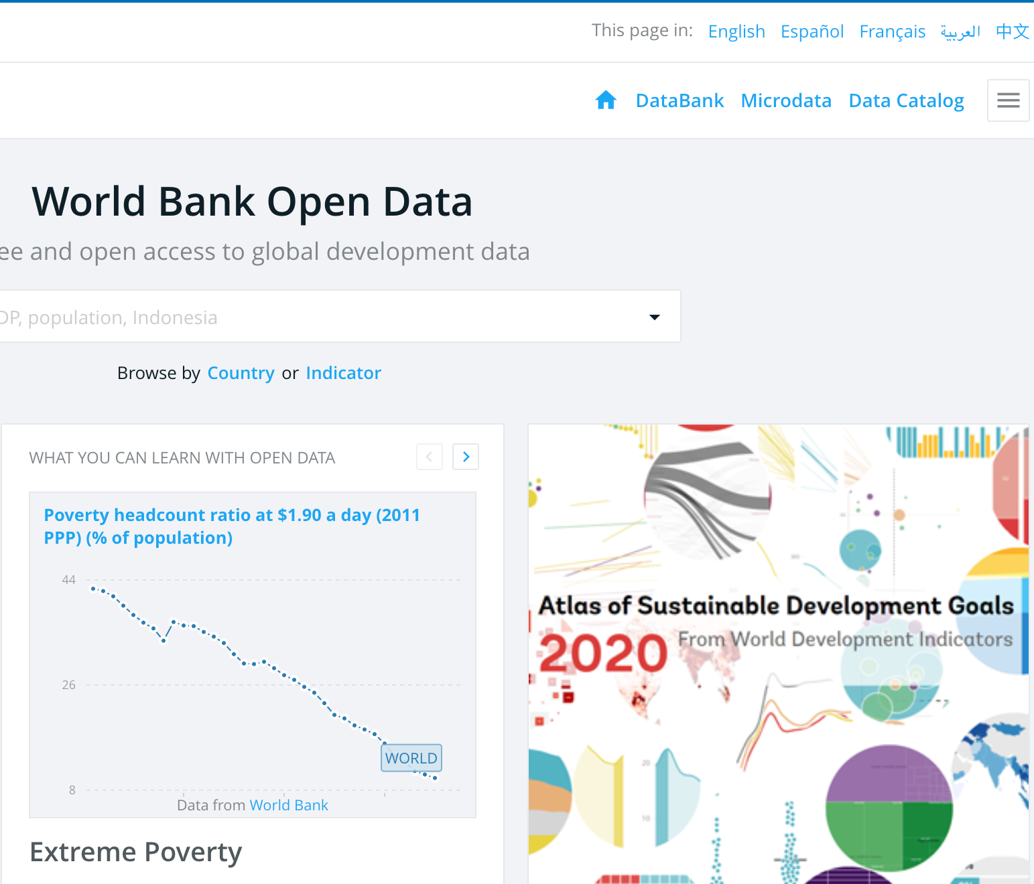
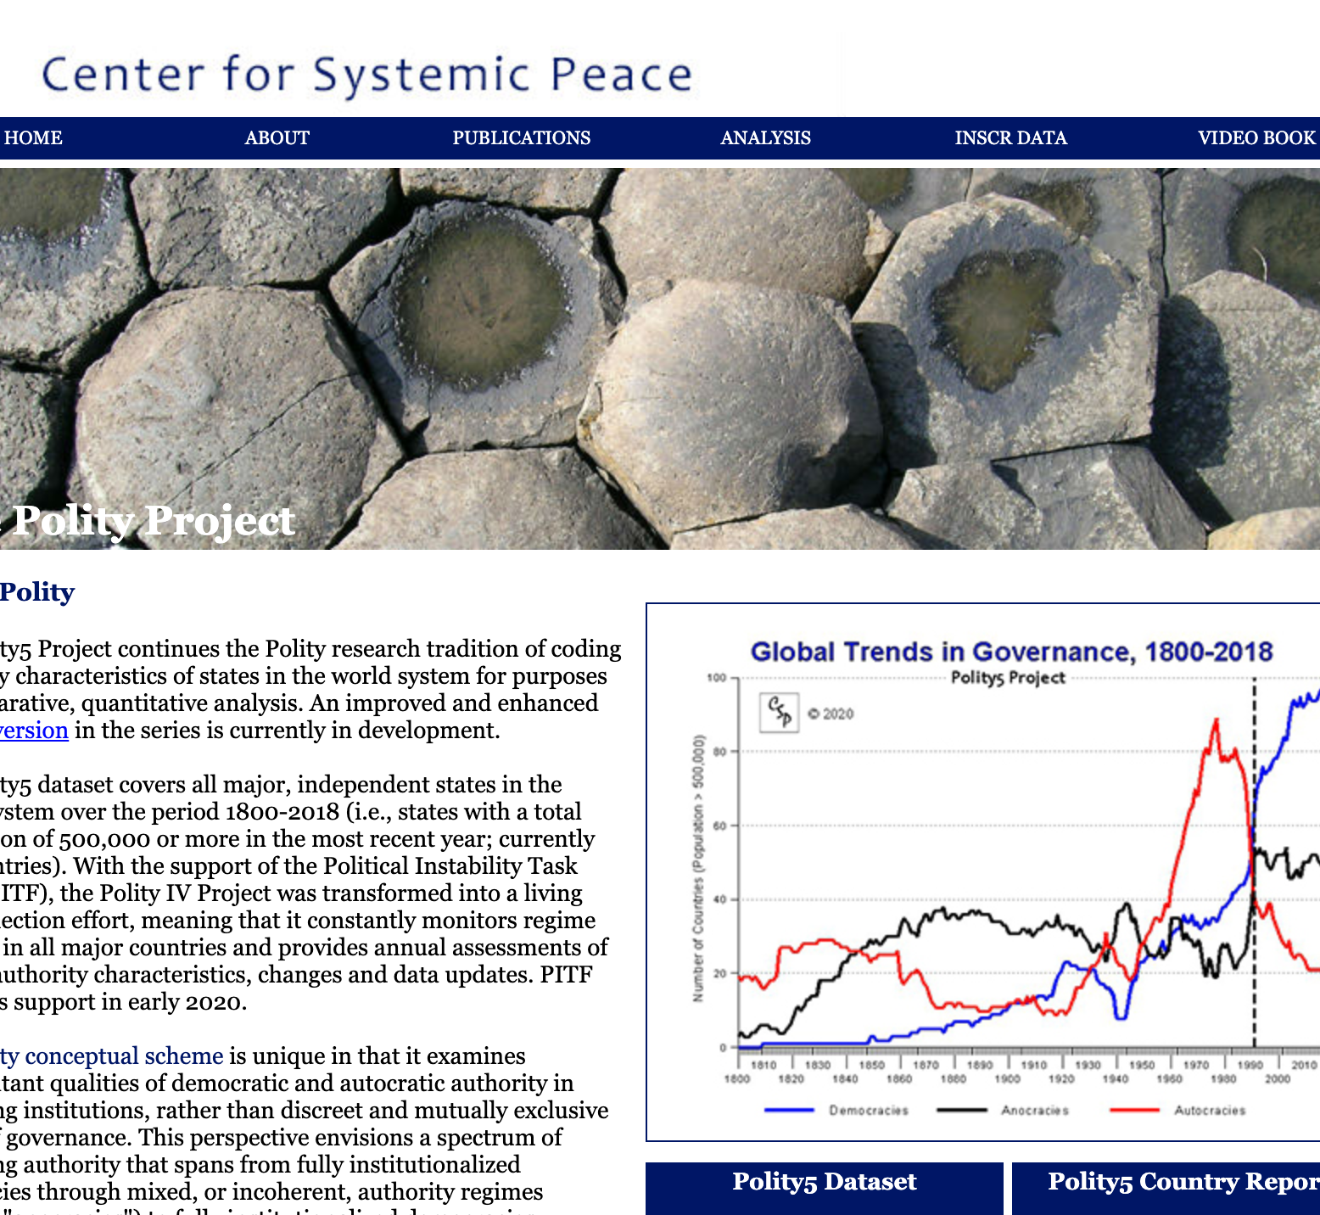
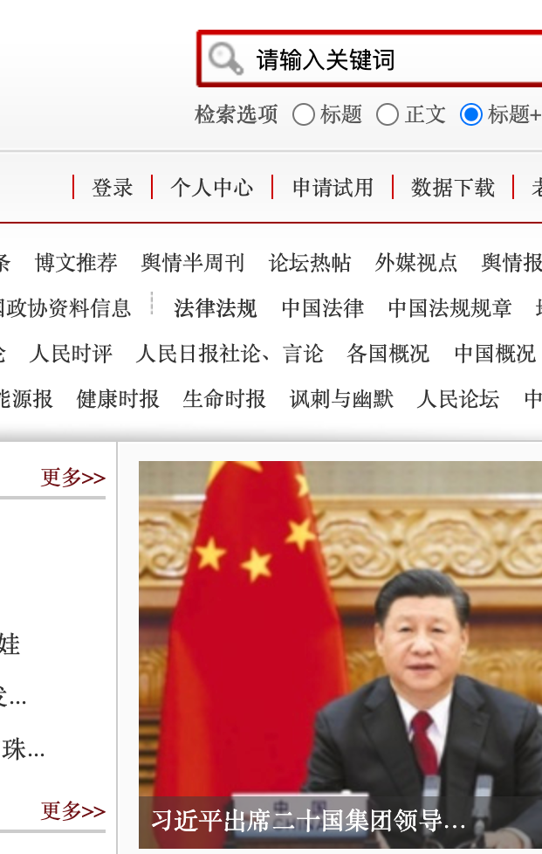
Data Involved
People’s Daily: articles about “China Threat”
(a suboptimal substitute)
http://data.people.com.cn/publish/_s1/0819.html
World Bank Database: GDP, military expenditure
https://data.worldbank.org/
Polity Project: Polity V
https://www.systemicpeace.org/polityproject.html

Slide 3
Steps
Webscraping People’s Daily
Categorizing different types of threat
As economic, military or political threat
Importing GDP, military expenditure and Polity V data
Processing Data
Ploting
Regression

Slide 4
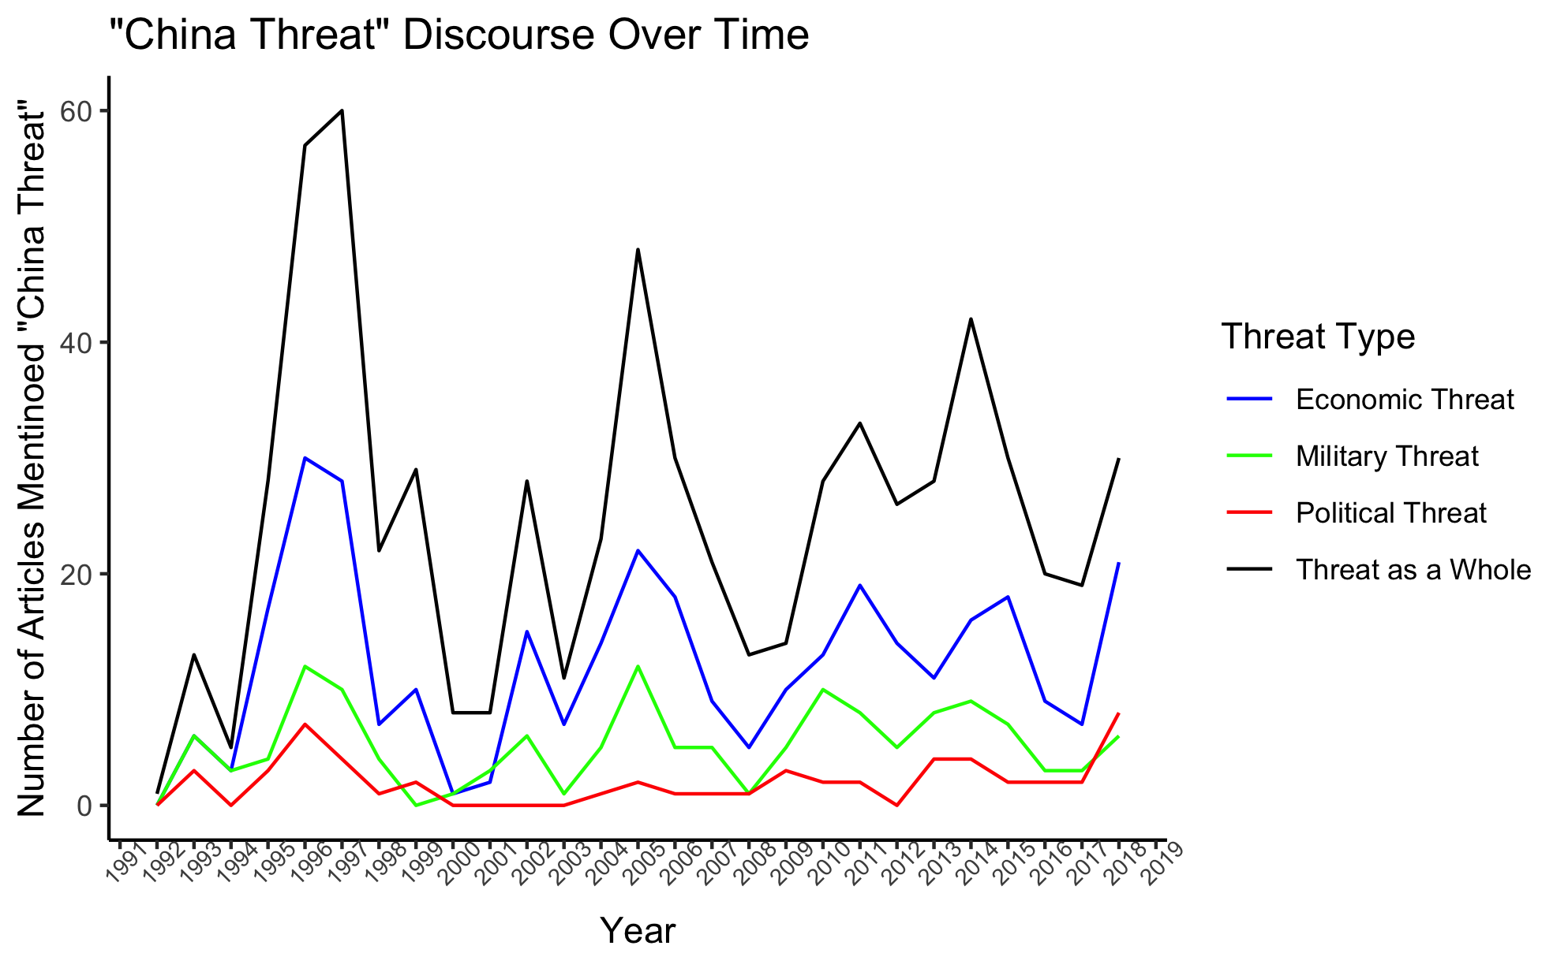
Results

Slide 5
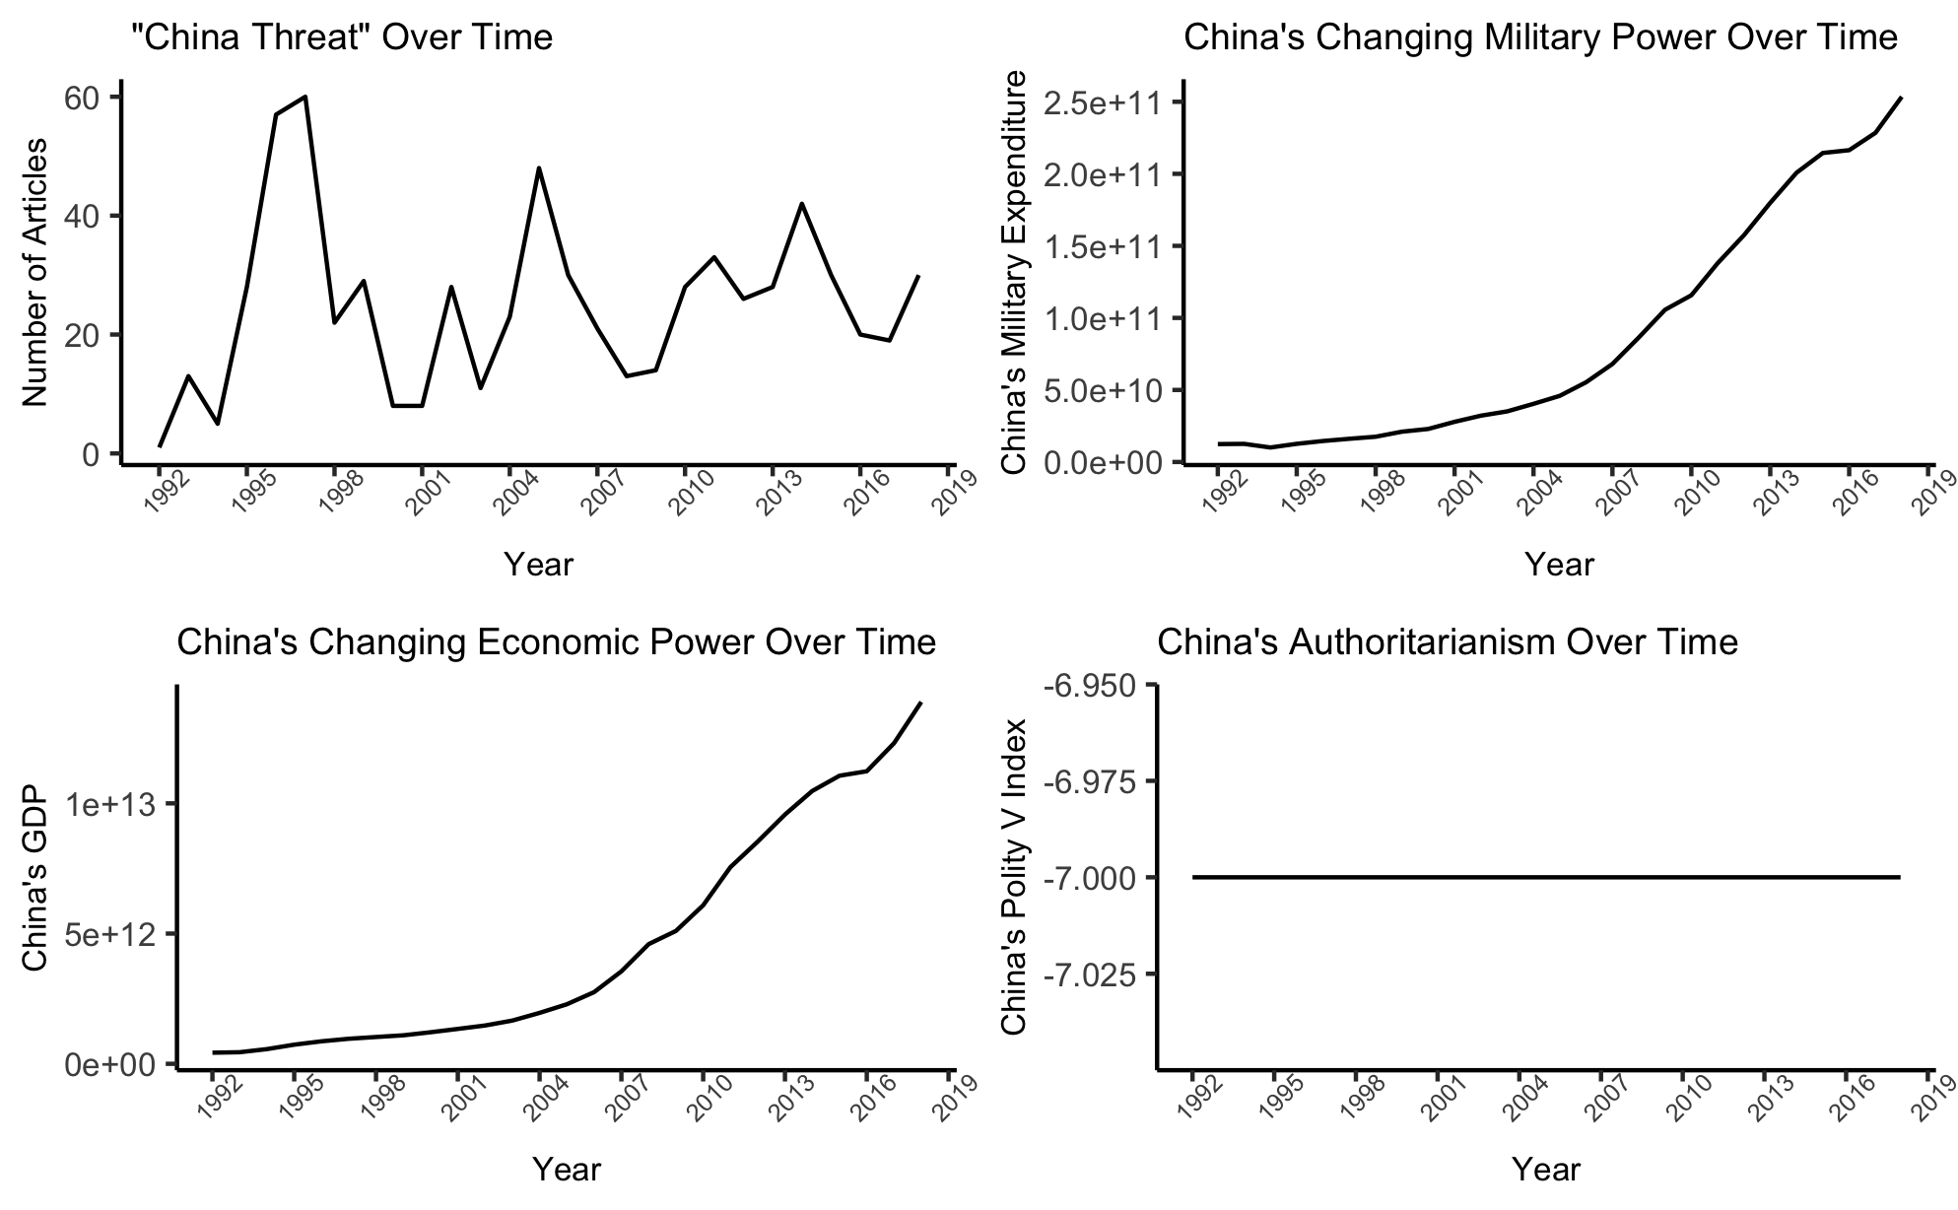
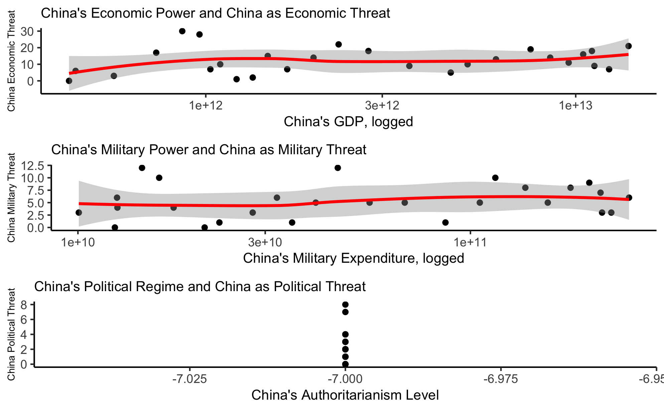
Results

Slide 6
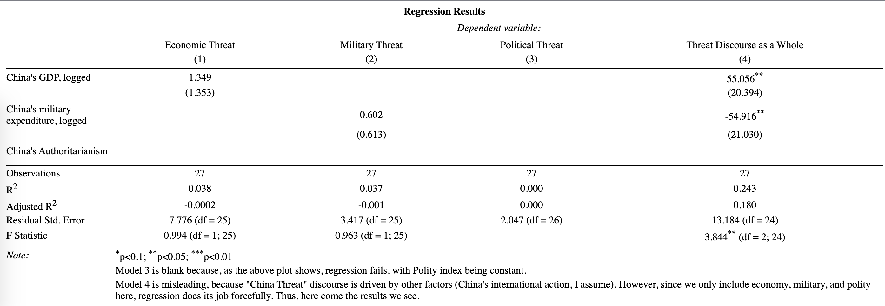
Results

Slide 7
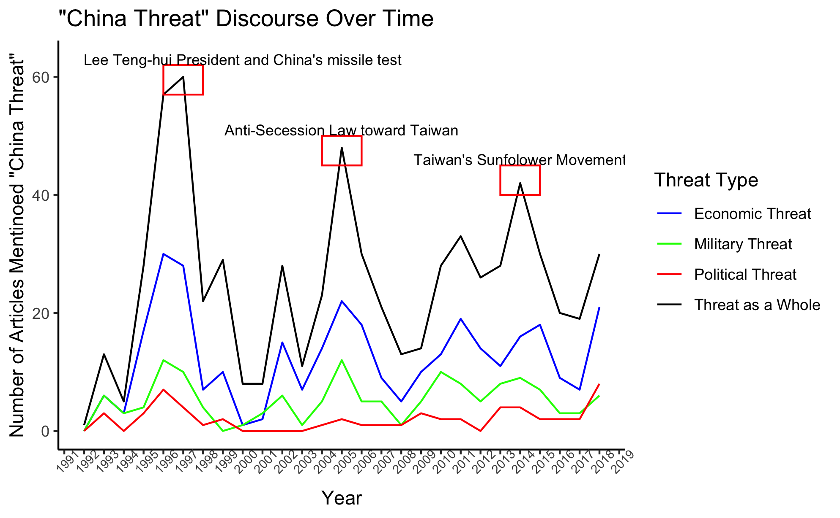
Results
Not what China is (China’s national capabilities),
But what China does (China’s international behavior)?
Threat:
Proximity
Offensive power
Aggressive intention
Aggregate power
Don’t matter,
as just shown
constat

Slide 8
Future Work
When China strong enough, what China is will kicks in?
Is People’s Daily reflection of Western Media?
Correlation between China’s international behavior with “China Threat” discourse?

Slide 9
Thank you for your attention!
Gilbert Lai

